Slide 1
NAAN MUDHALVAN SCHEME FUNDAMENTALS OF DATA LITERACY WITH TABLEAU
PROJECT TITLE: SUBSCRIBERS GALORE: EXPLORING WORLD’S TOP YOUTUBE CHANNELS
TEAM ID: NM2023TMID15995
TEAM LEAD ID: EDFF7320F87F2AA2FA40E5D8E74037

Slide 2
TEAM MEMBERS ID:
9111DA1A2E2730FA8AC4BF967BC0E137
004B3087D9ED81CA5BA46B66A4D7BFF7
746538B1041605DBBF04F46DCF8537F4

Slide 3
INTRODUCTION: Subscribers Galore: Exploring World’s Top YouTube Channels
A subscriber to a channel on the video-sharing YouTube is a user who has chosen to receive the channel’s “Subscriber” button, and each user’s subscription feed consists of videos published by channels to which the user is subscribed. The ability to subscribe to users was introduced in October 2005. YouTube began publishing a list of its most-subscribed channels in April 2006. An early archive of the list dates to May 2006.

Slide 4
EMPATHY MAP AND BRAINSTROMING MAP

Slide 7
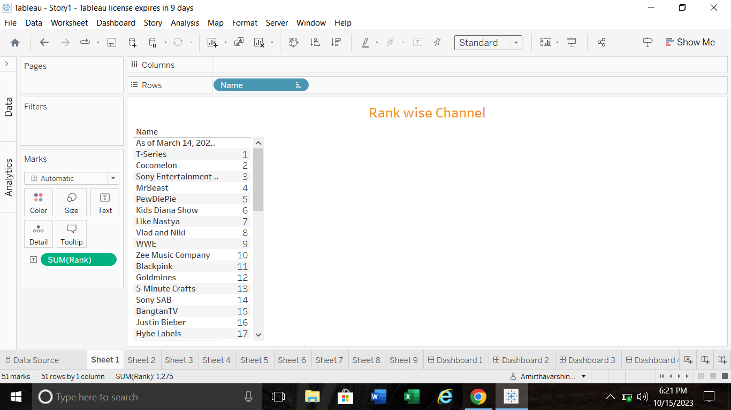

Slide 8
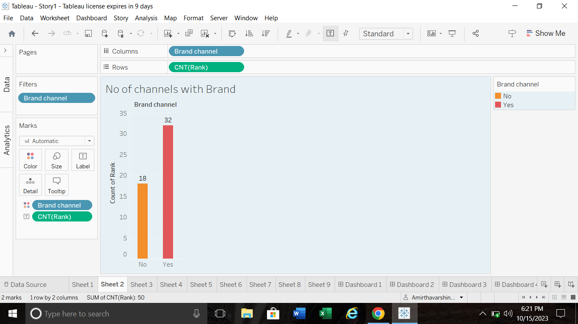

Slide 9
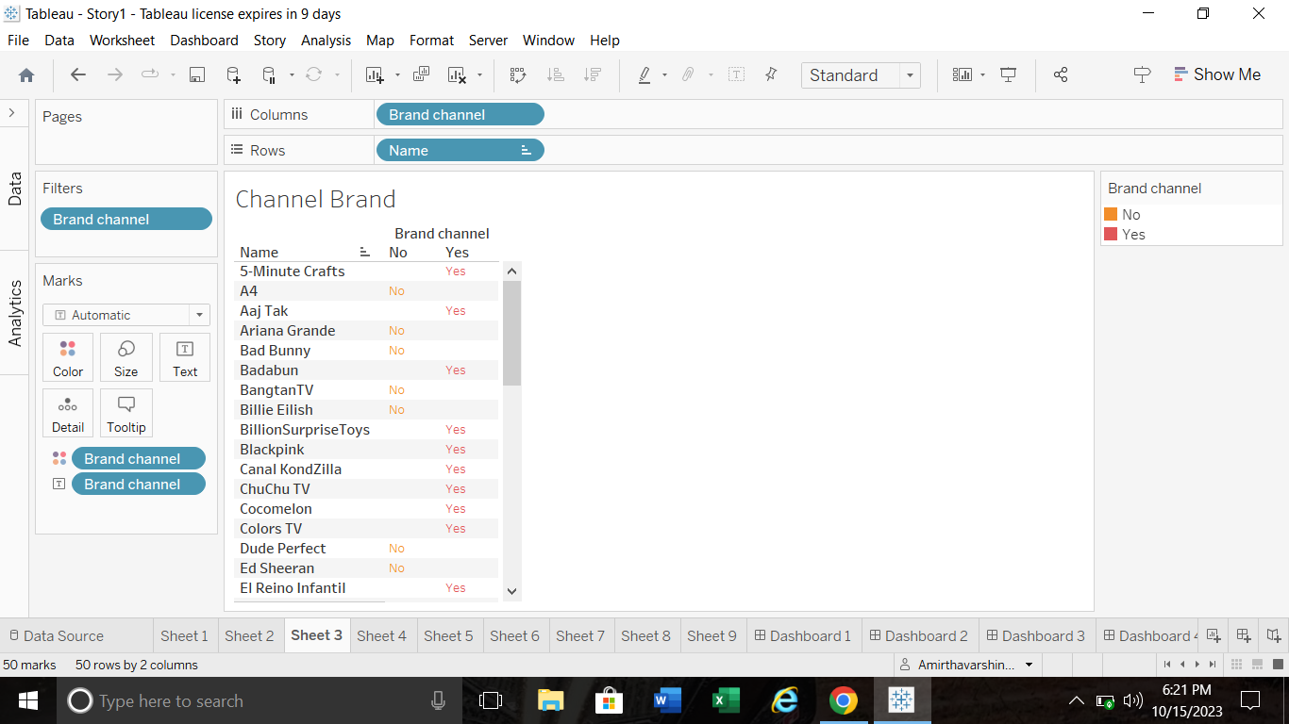

Slide 10
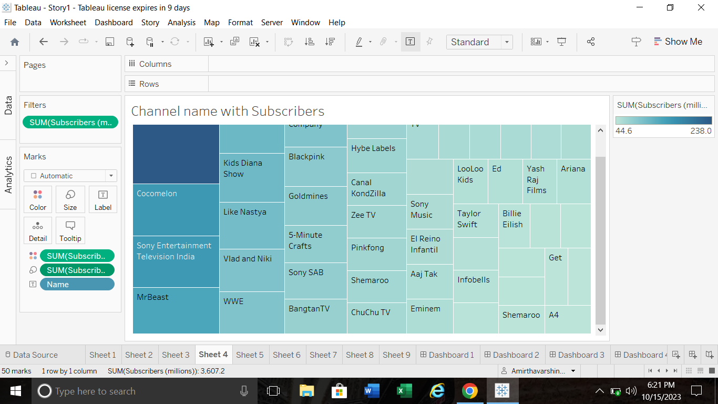

Slide 11
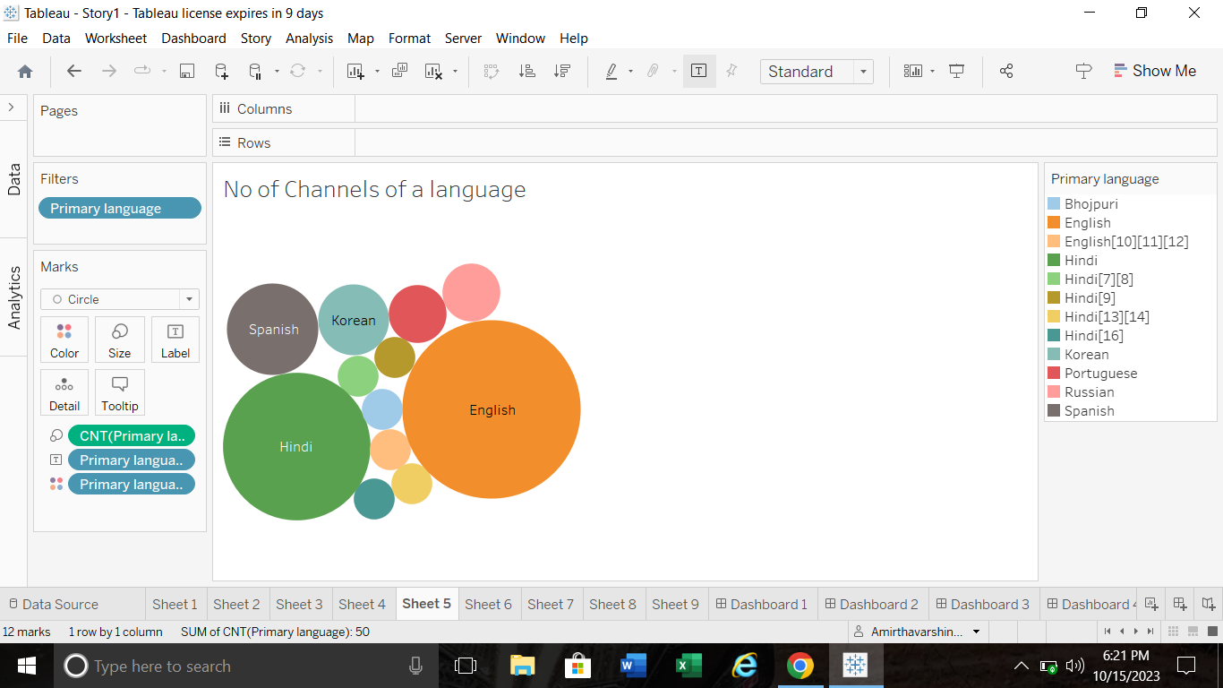

Slide 12
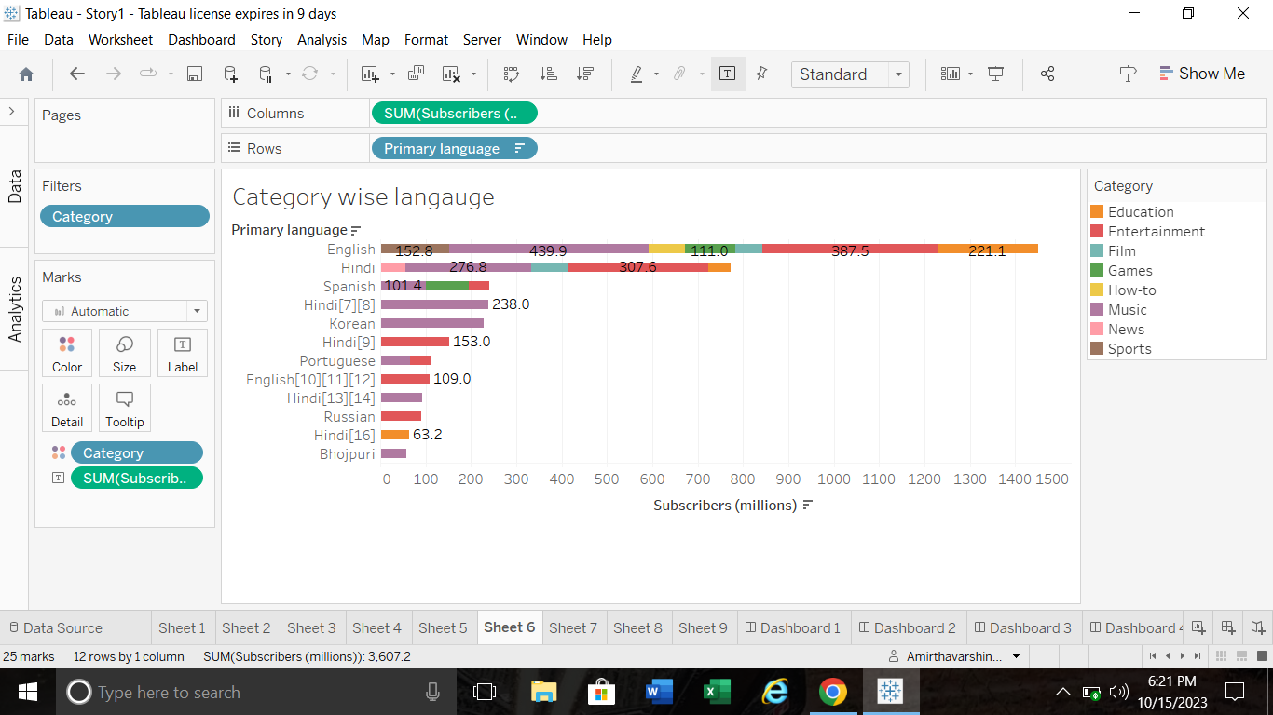

Slide 13
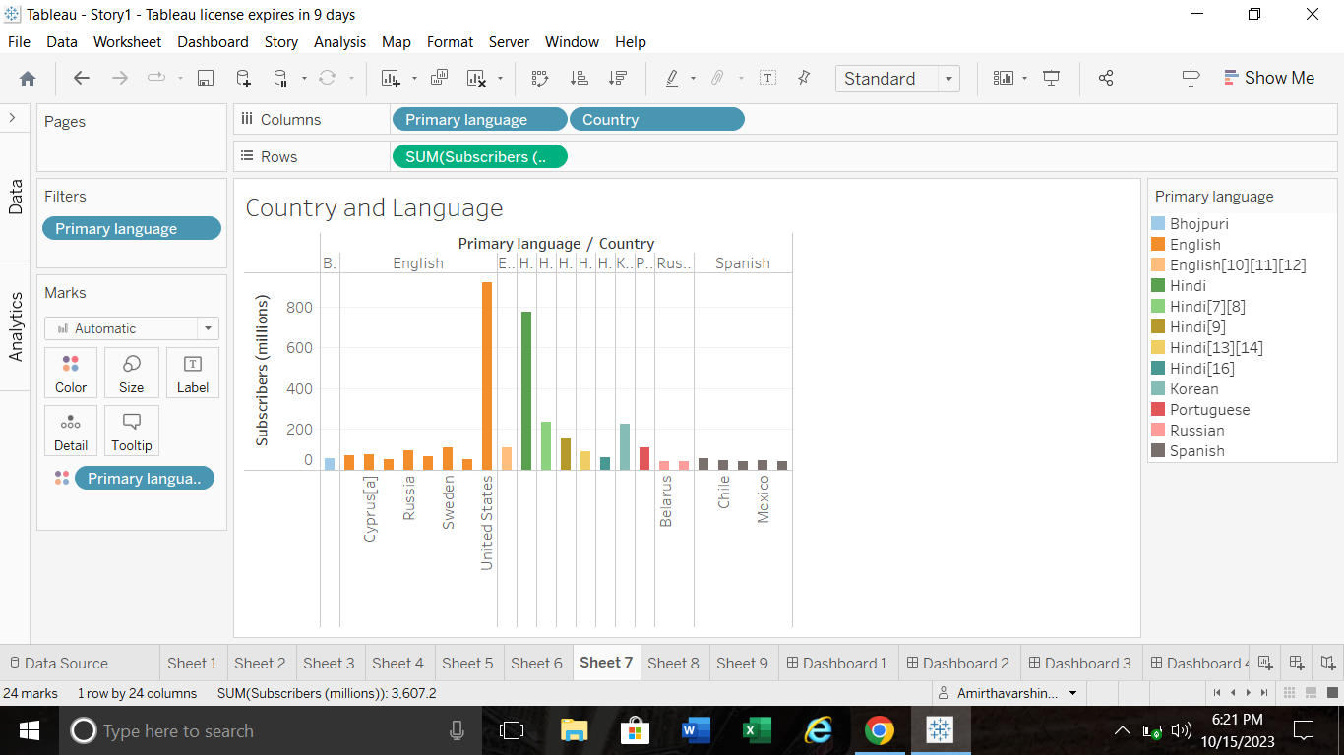

Slide 14
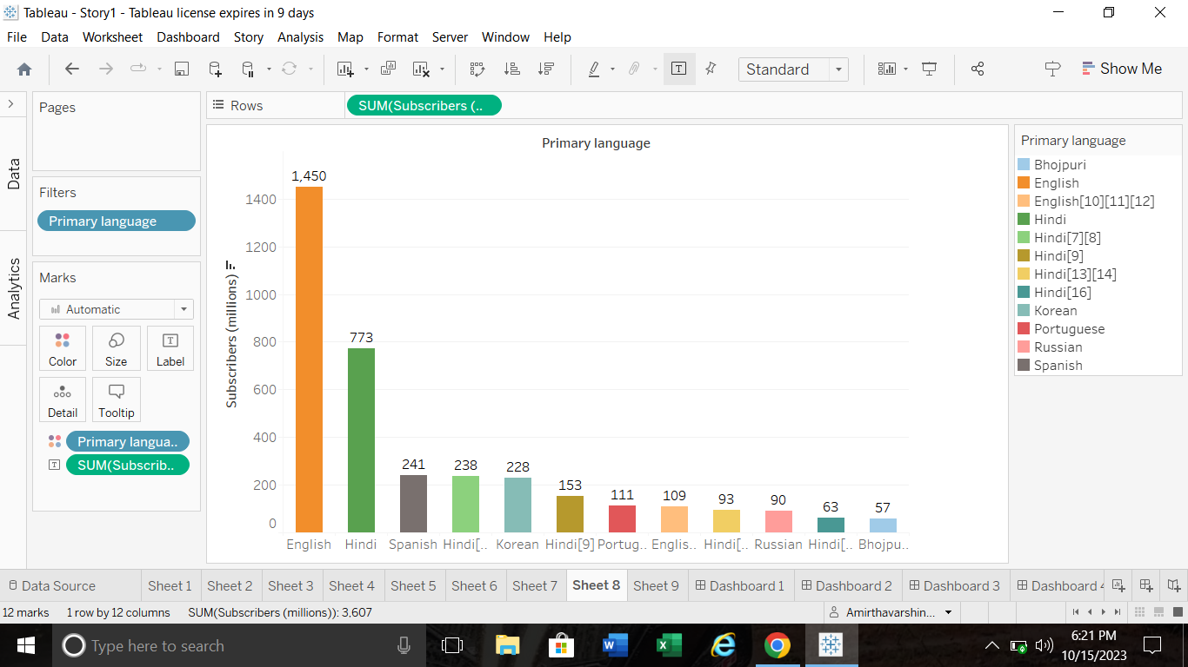

Slide 15
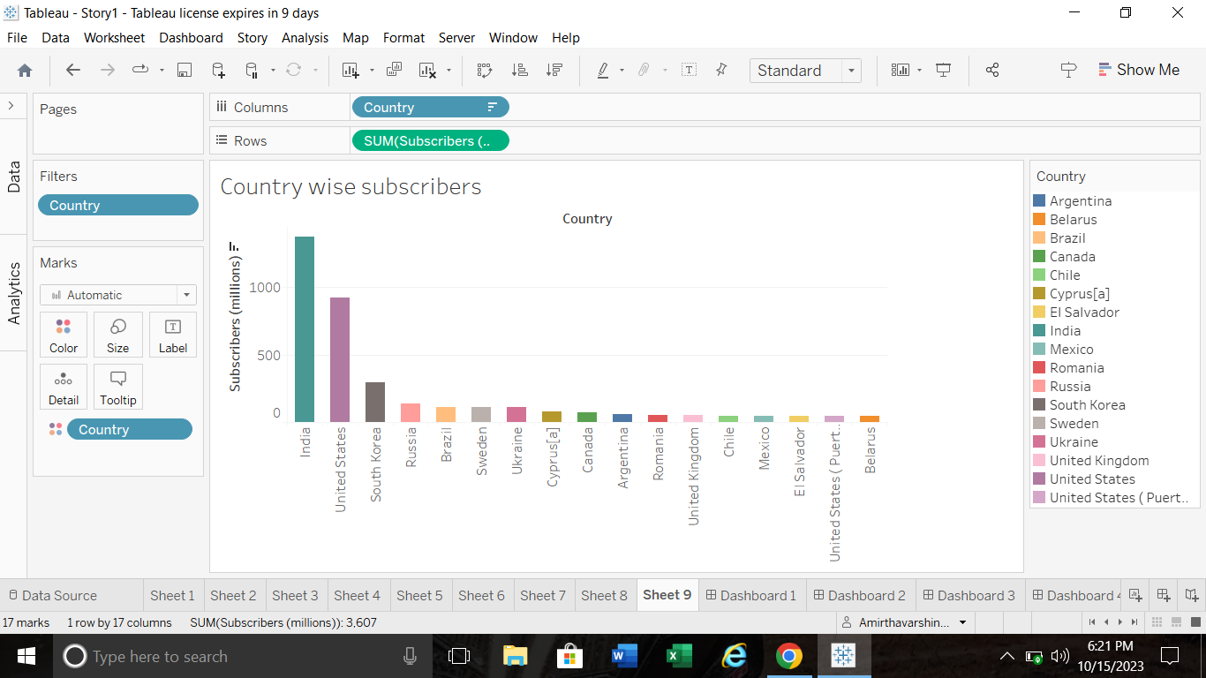

Slide 16
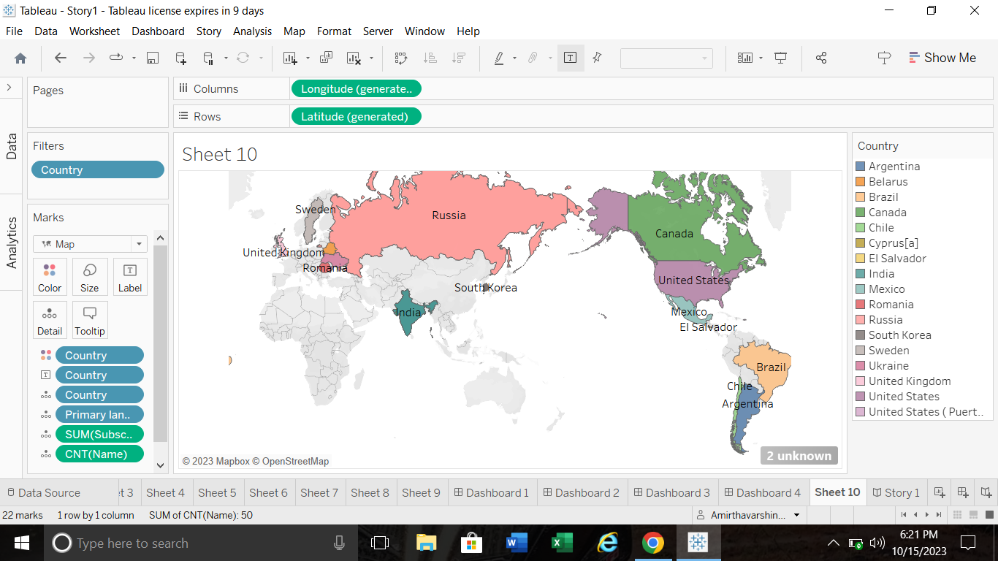

Slide 17
DASHBOARDS

Slide 18
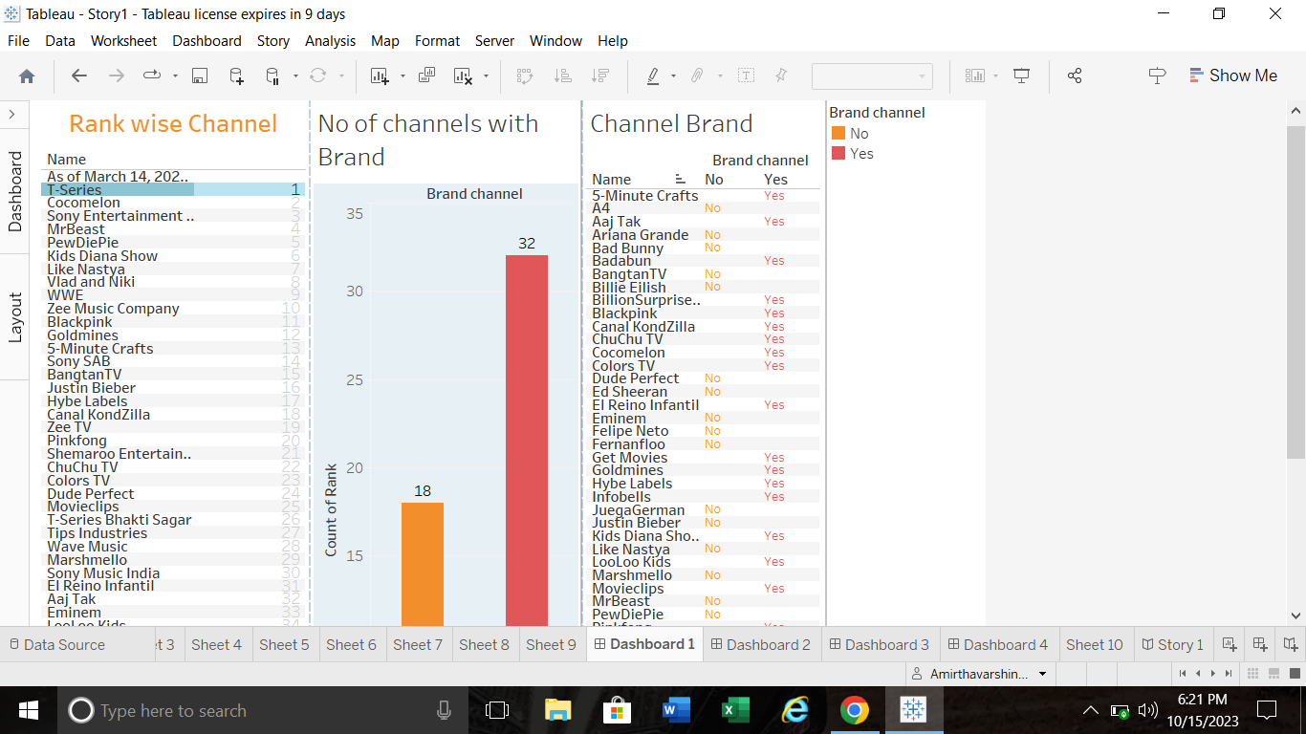

Slide 19
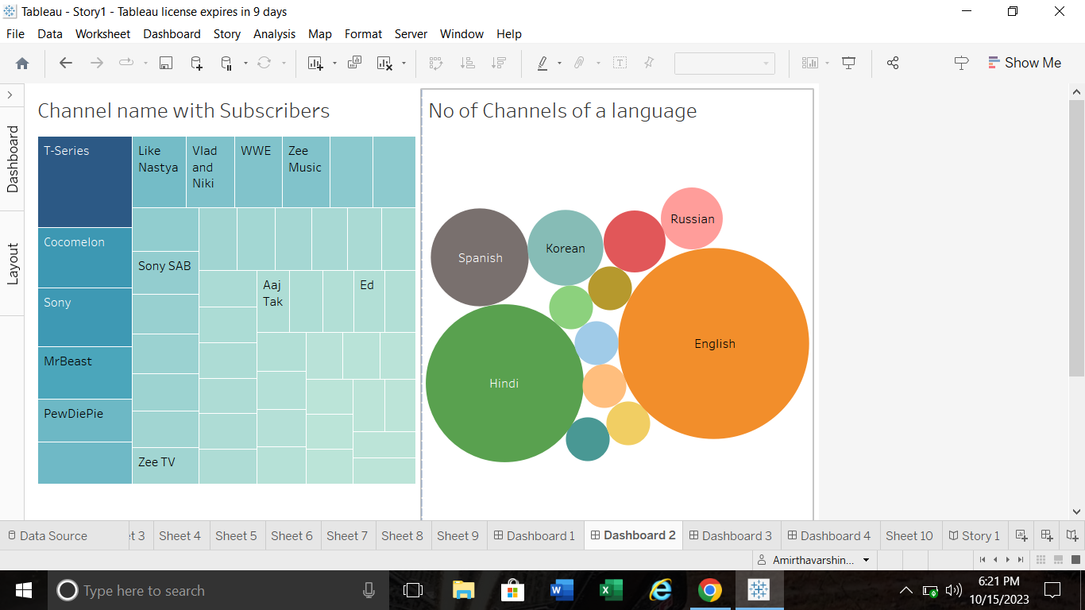

Slide 20
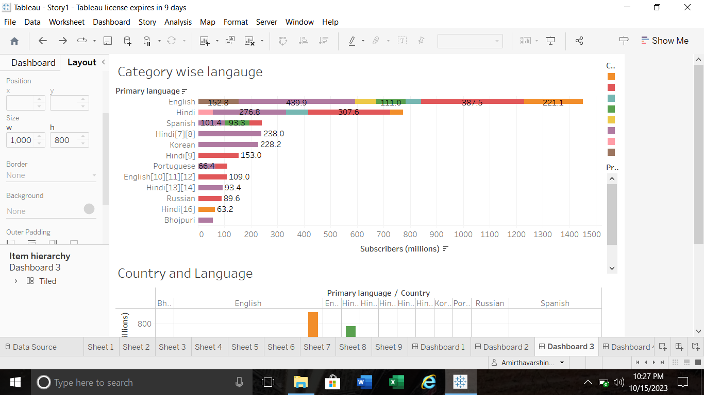

Slide 21
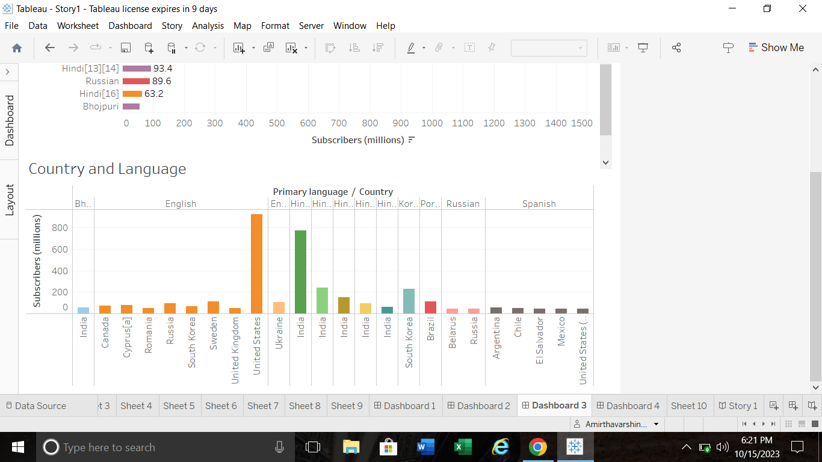

Slide 22
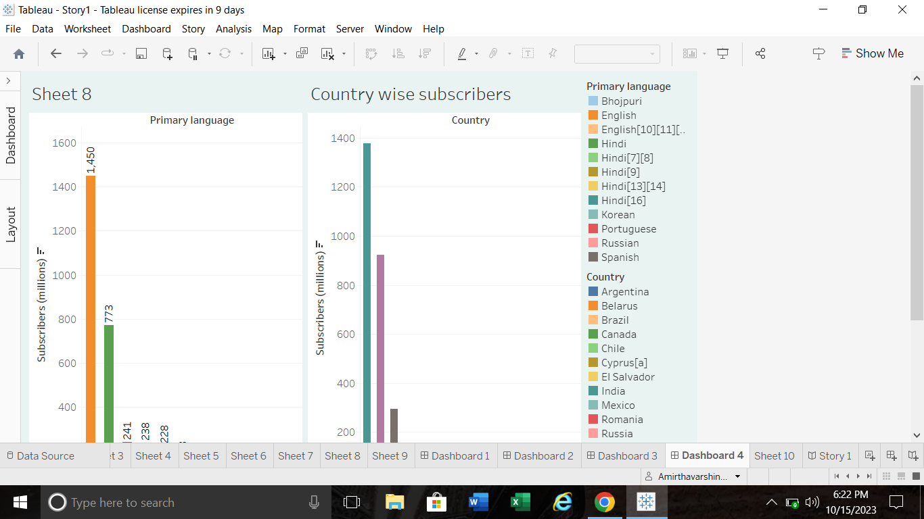

Slide 23
STORY

Slide 24
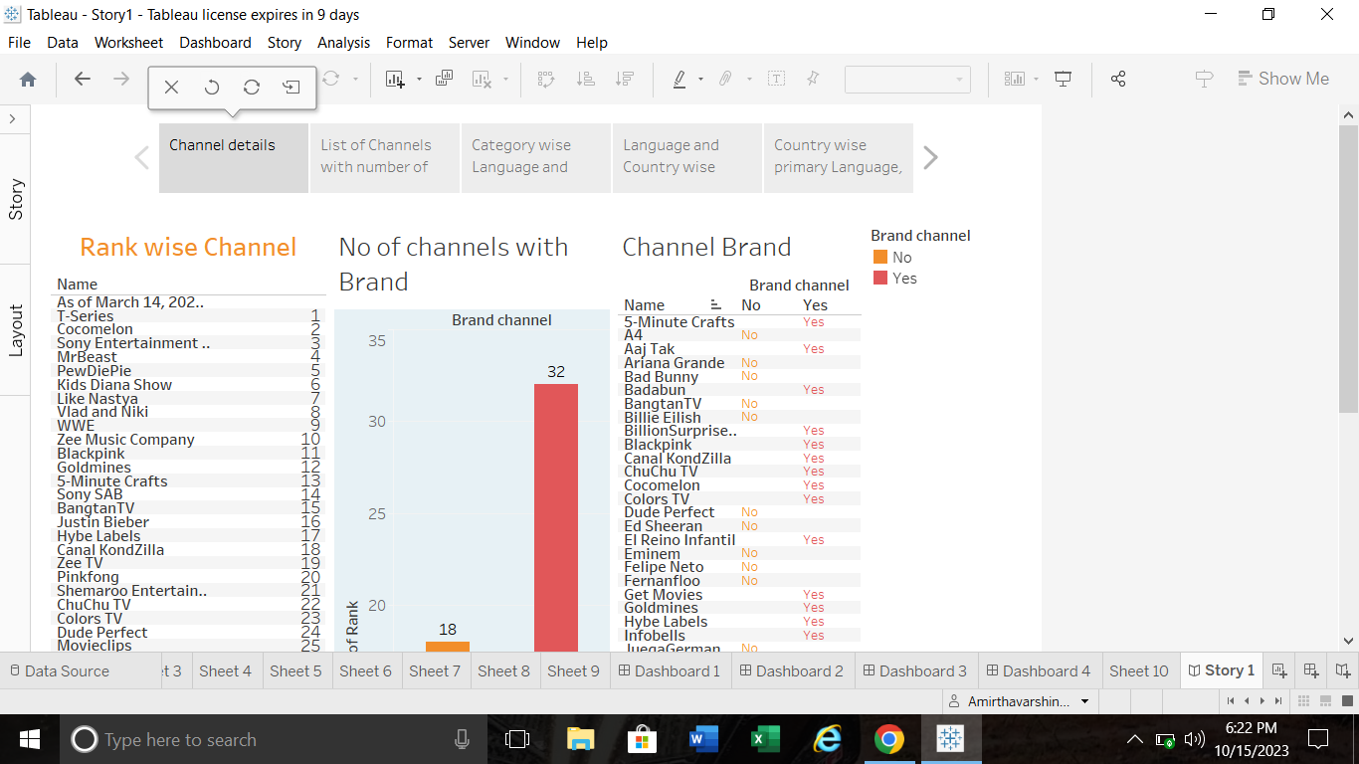

Slide 25
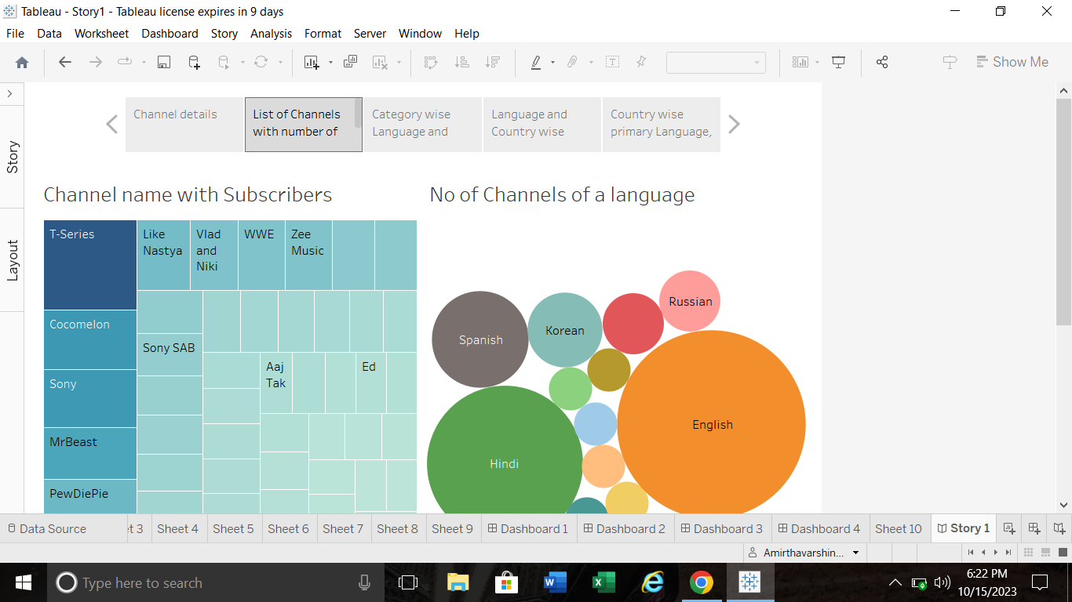

Slide 26
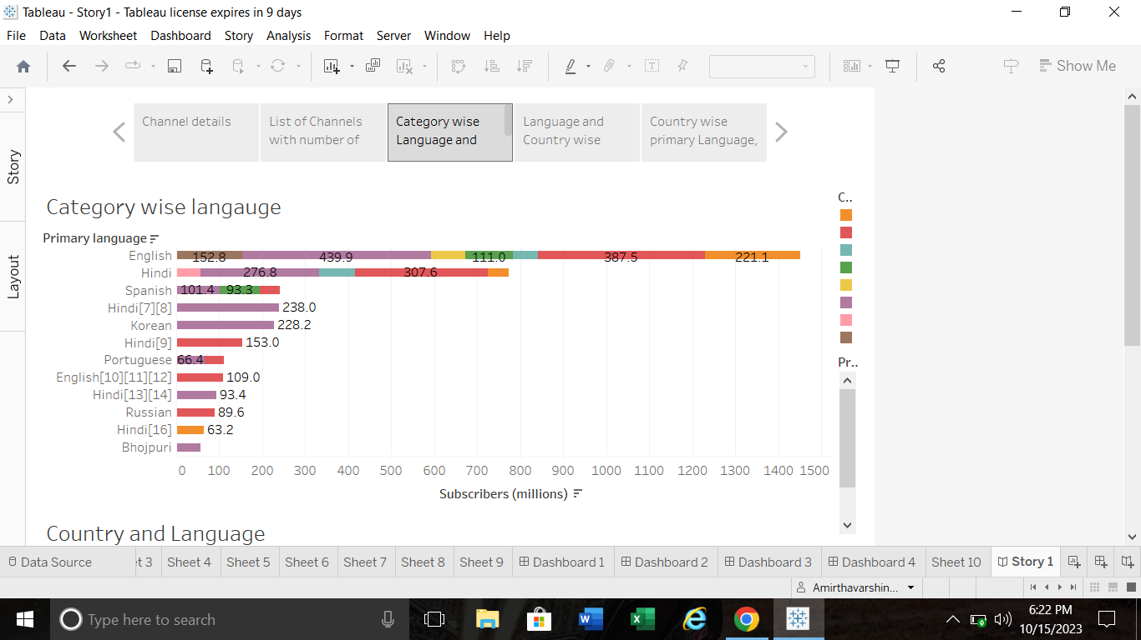

Slide 27
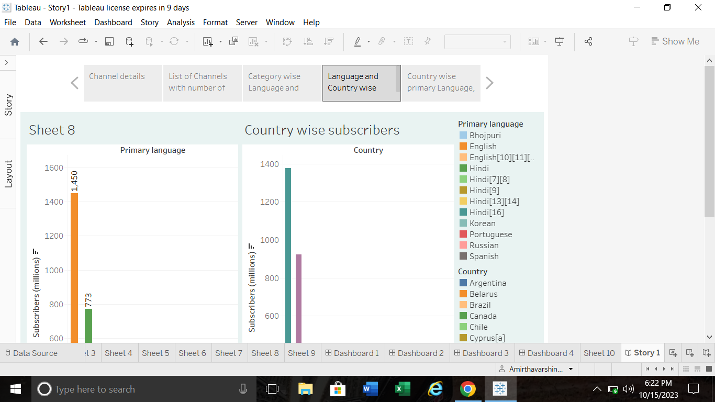

Slide 28
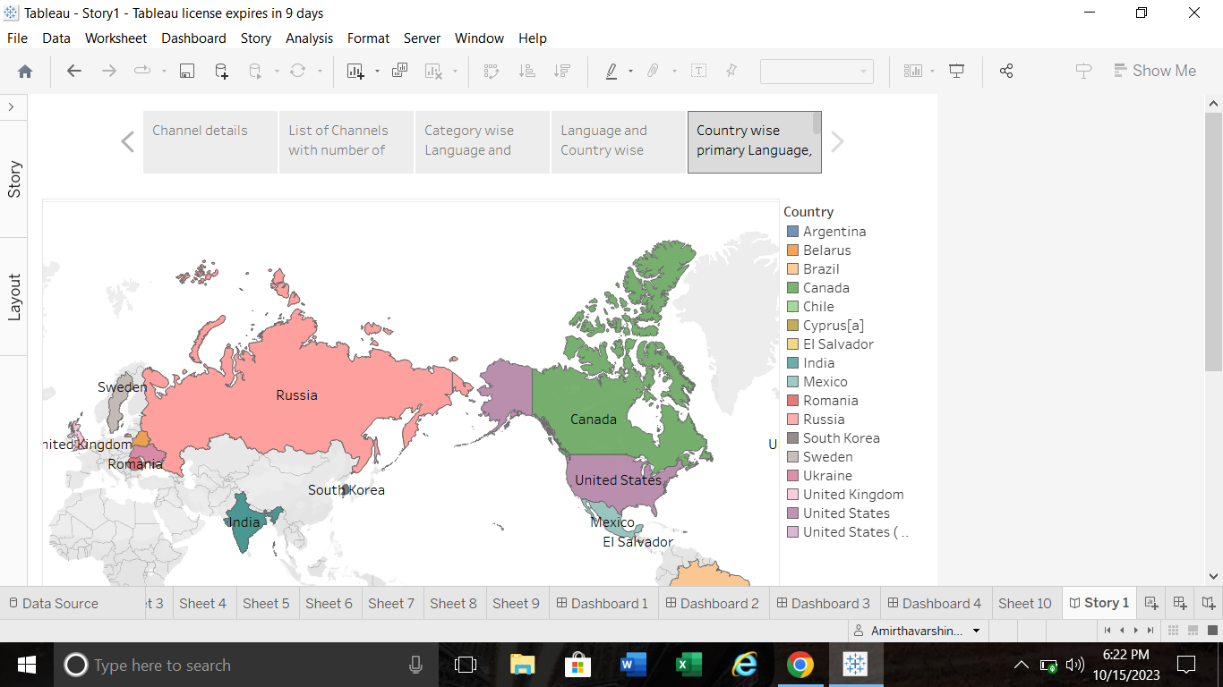

Slide 29
PUBLISHING

Slide 30
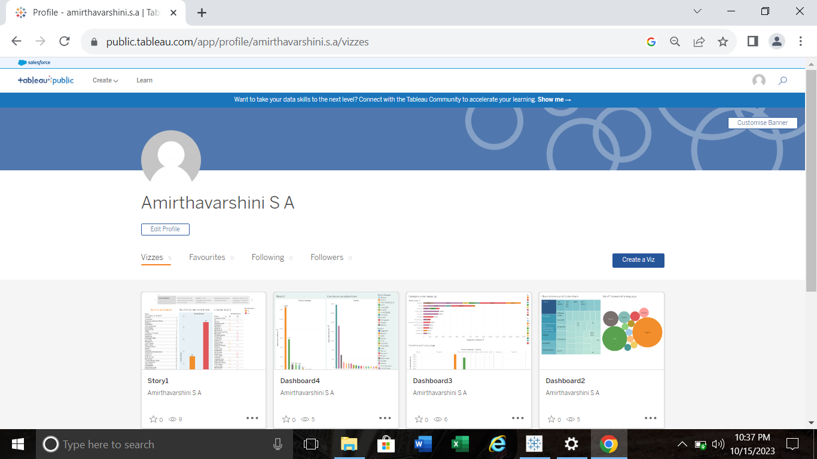

Slide 31
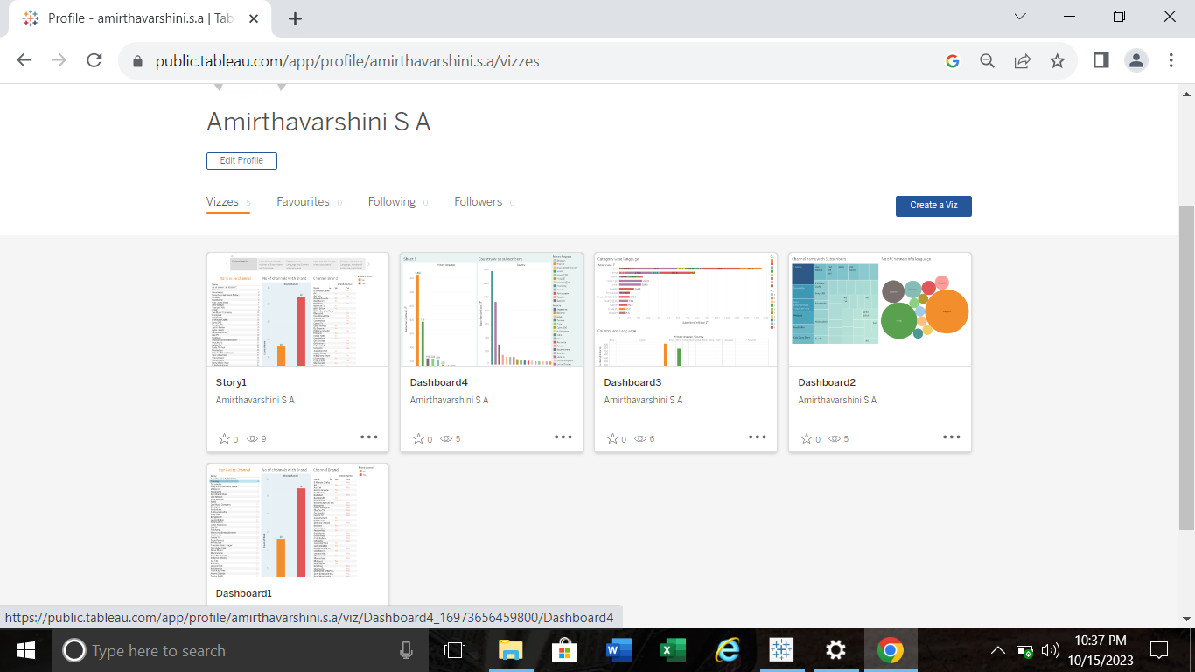

Slide 32
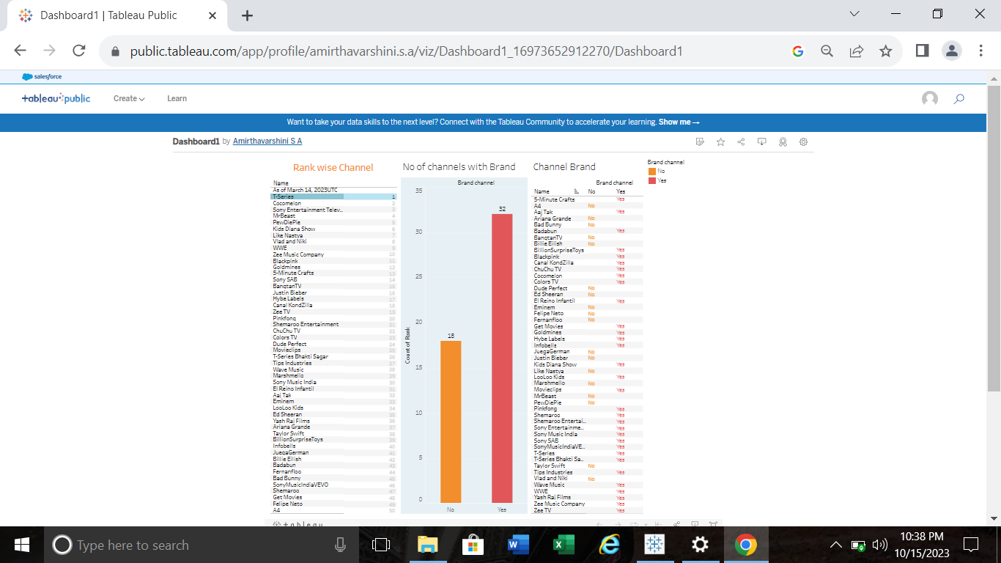

Slide 33
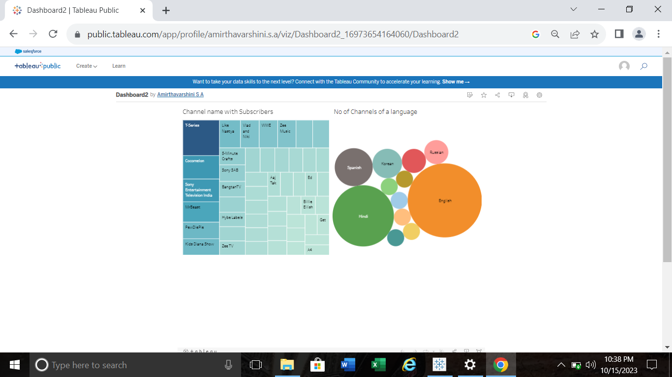

Slide 34
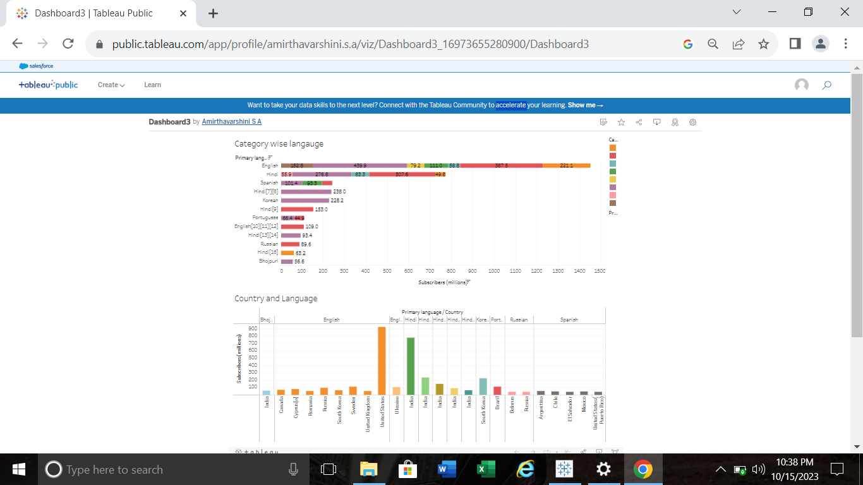

Slide 35
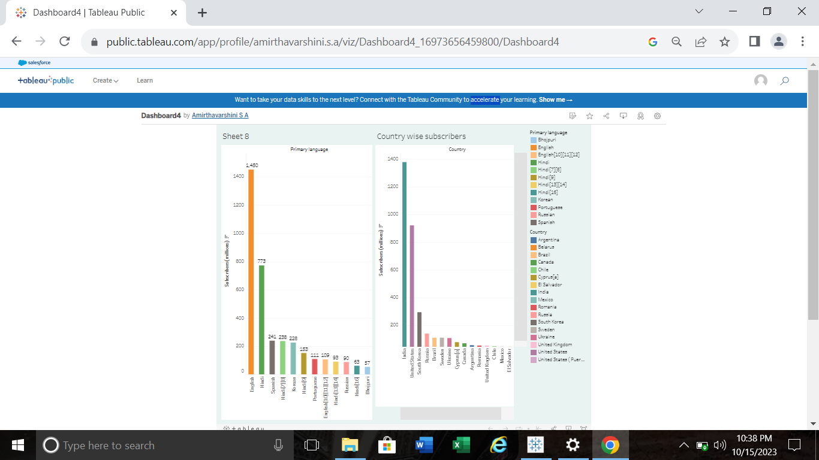

Slide 36
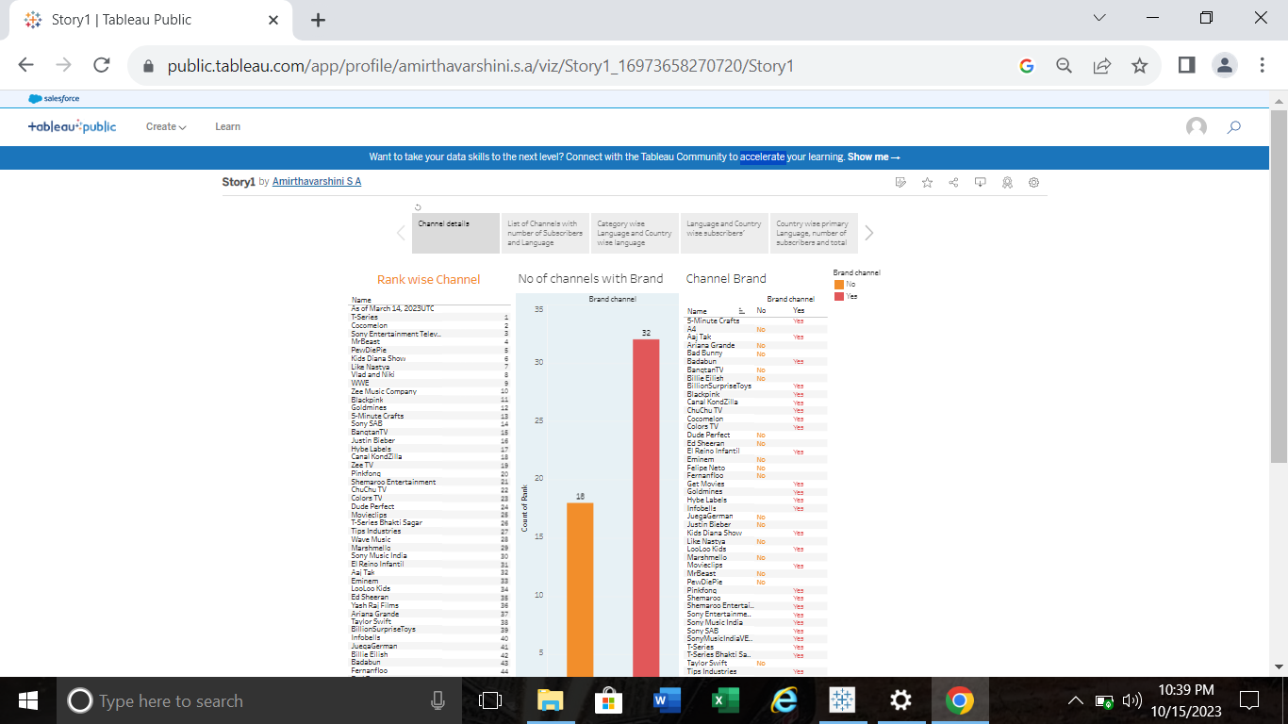

Slide 37
THANK YOU

